Slide 1


Ce443 : Cloud computing
Introduction to cloud computing

Slide 2
Credits and Hours:
Teaching Scheme | Theory | Practical | Total | Credits
Hours/week | 3 | 2 | 5 | 4
Marks | 100 | 50 | 150
Pre-requisites Courses:
Operating Systems
Networking

Slide 3
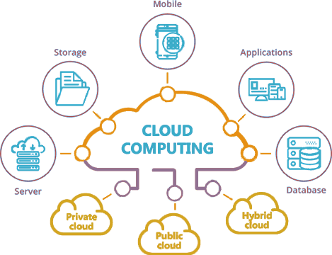
Cloud Computing
The cloud refers to servers that are accessed over the Internet, and the software and databases that run on those servers. Cloud servers are located in data centers all over the world
Cloud computing is the on-demand availability of computer system resources, especially data storage (cloud storage) and computing power, without direct active management by the user

Slide 4
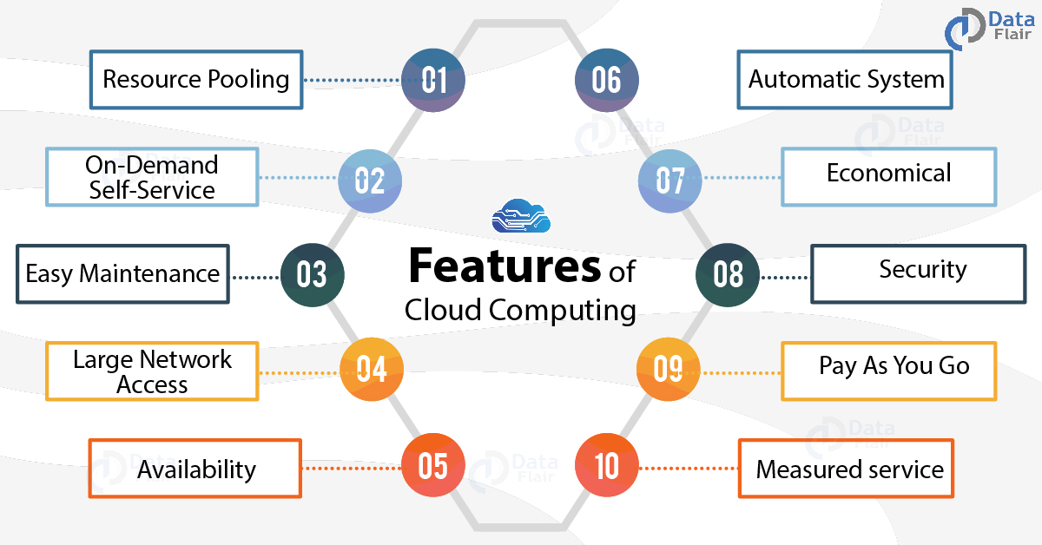

Slide 5
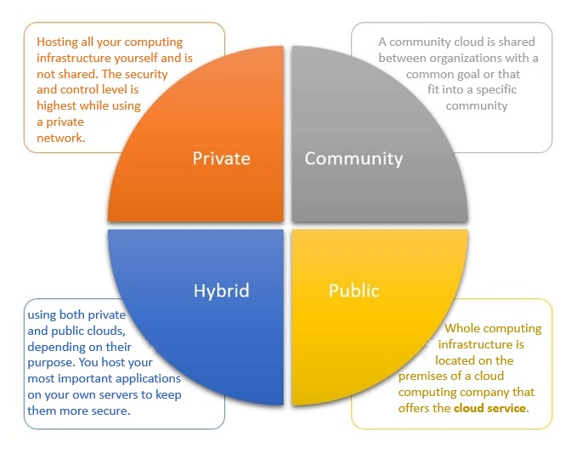
Types of Cloud

Slide 6
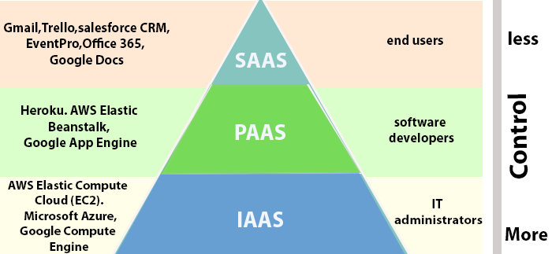
Types of Cloud Services

Slide 7
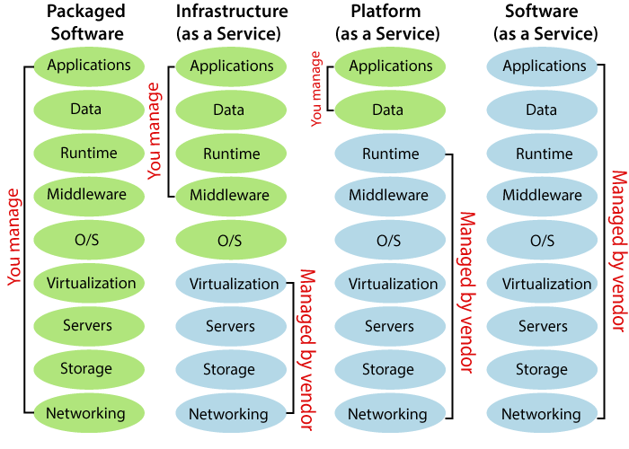
Types of Cloud Services

Slide 8
Thank You

